Slide 1
The Network Layer – Part 3
Notes:
选修部分= =

Slide 2
Contents
Congestion Control Algorithms (Section 5.3 )
  General Principles of Congestion Control
  Congestion Prevention Policies
  Congestion Control in Virtual-Circuit Subnets
Quality of Service (Section 5.4)
  QoS Requirements
  Techniques for Achieving Good Quality of Service
  Internet QoS Architecture
    Integrated Services
    Differentiated Services
    Label Switching and MPLS

Slide 3
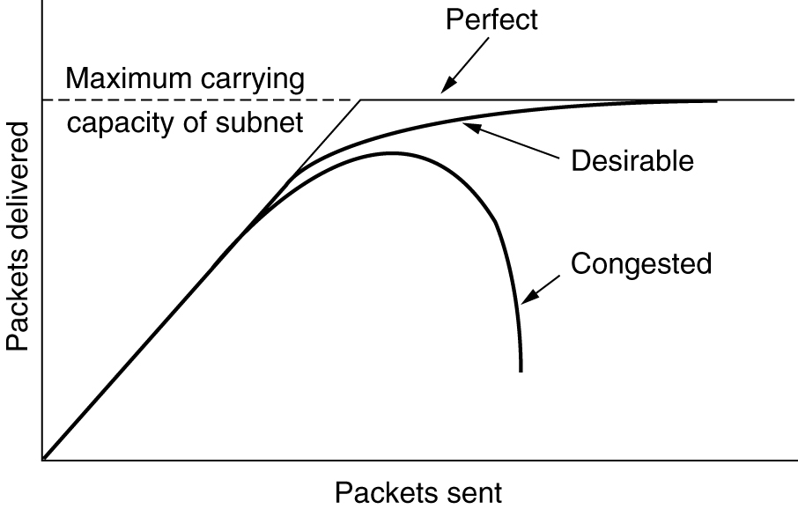
Congestion
If all of a sudden, streams of packets begin arriving on three or four input lines and all need the same output line, a queue will build up.
When too much traffic is offered, congestion sets in and performance degrades sharply.
Notes:
网络拥塞：
在某个时刻到达一个路由器的流量（数据包）过多

Slide 4
General Principles of Congestion Control
Many problems complex systems, such as computer networks, can be viewed from a control theory point of view
  open loop: attempt to solve the problem by good design; make decisions without regard to the current state of the network
  closed loop: based on the concept of a feedback loop
The closed loop solutions:
  Monitor the system: detect when and where congestion occurs.
  Pass information to where action can be taken.
  Adjust system operation to correct the problem.
A variety of metrics can be used to monitor the subnet for congestion.
  the percentage of all packets discarded;
  the average queue lengths;
  the number of packets that time out and are retransmitted;
  the average packet delay ;
  the standard deviation of packet delay
Notes:
解决拥塞的办法：
1.控制终端主机发送的数据量
2.根据网络的状况进行控制：闭环控制The closed loop solutions，监测网络状态，将结果返回给终端主机，然后调整

Slide 5
General Principles of Congestion Control(2)
A taxonomy for congestion control algorithms
  open loop algorithms :
    the open loop algorithms that act at the source;
    the open loop algorithms that act at the destination
  closed loop algorithms:
    explicit feedback algorithms: packets are sent back from the point of congestion to warn the source
    implicit feedback algorithms: the source deduces the existence of congestion by making local observations, such as the time needed for acknowledgements to come back

Slide 6
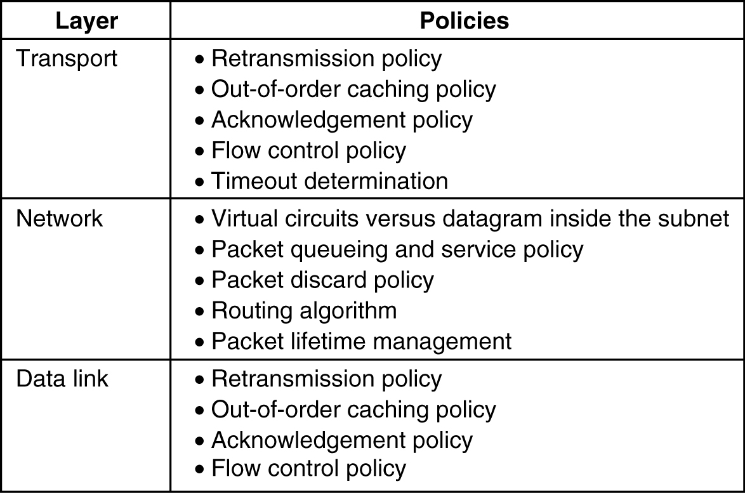
Congestion Prevention Policies
5-26
Policies that affect congestion.

Slide 7
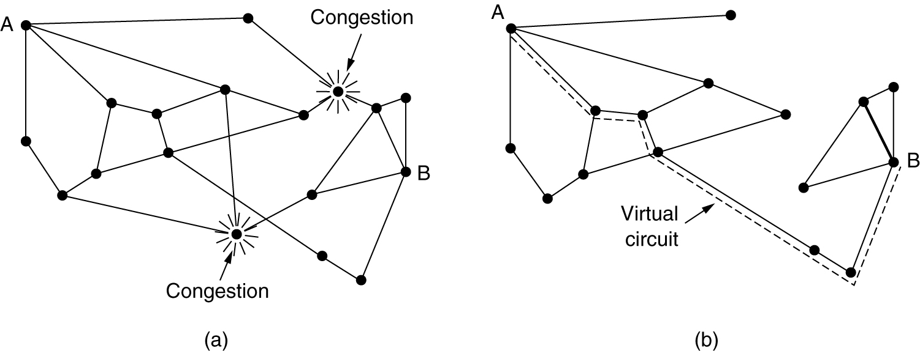
Congestion Control in Virtual-Circuit Subnets
(a) A congested subnet. (b) A redrawn subnet, eliminates congestion and a virtual circuit from A to B.

Slide 8
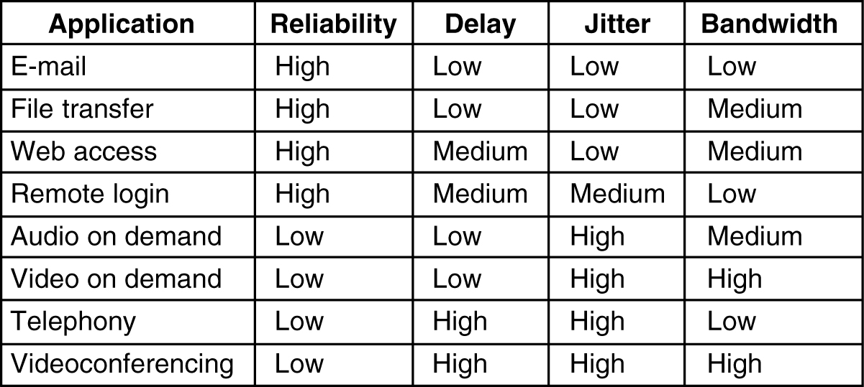
QoS Requirements
5-30
How stringent the quality-of-service requirements are.
Notes:
实时业务：
在传输的过程中不应该有过多的时延
而E-mail是非实时的，所以delay是LOW
远程操控：实时中等，比电话要低

Slide 9
Techniques for Achieving Good Quality of Service
Overprovisioning
Buffering:
  Flows can be buffered on the receiving side before being delivered.
Traffic Shaping: is about regulating the average rate (and burstiness) of data transmission
  Monitoring a traffic flow is called traffic policing
  The Leaky Bucket Algorithm, Token Bucket Algorithm
Resource Reservation:
  Once we have a specific route for a flow, it becomes possible to reserve resources along that route to make sure the needed capacity is available
  Three different kinds of resources can potentially be reserved: 1) Bandwidth; 2) Buffer space; 3) CPU cycles

Slide 10
Techniques for Achieving Good Quality of Service
Admission Control:
  whether to admit or reject a flow?
Proportional Routing:
  to split the traffic for each destination over multiple paths.
Packet Scheduling
  Processing packets in the order of their arrival means that an aggressive sender can capture most of the capacity of the routers its packets traverse, reducing the quality of service for others.
  fair queueing algorithm: The essence of the algorithm is that routers have separate queues for each output line, one for each flow. When a line becomes idle, the router scans the queues round robin, taking the first packet on the next queue.

Slide 11
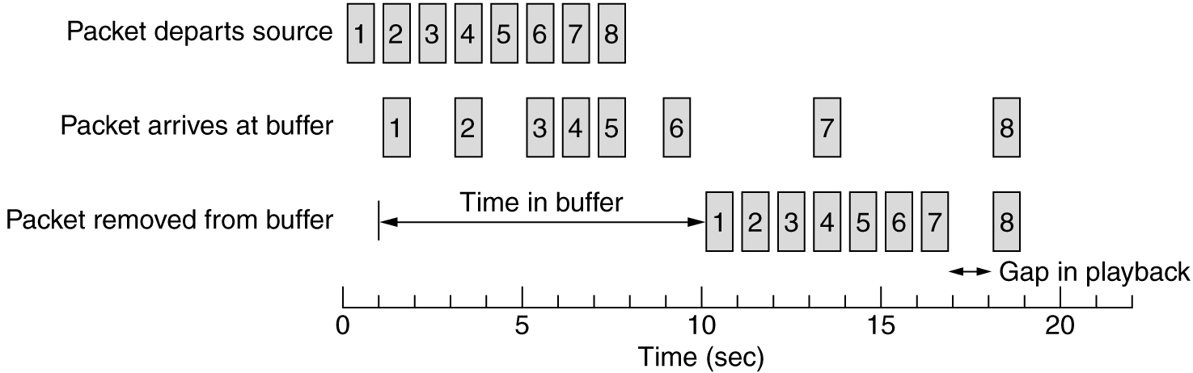
Buffering
Smoothing the output stream by buffering packets.
Notes:
将需要处理的数据预先一小部分部分在本地，之后视频边播边放，当遇到网络小抖动时也不会有影响，因为已经预先存了一部分，就是缓存啦= =
和下面那张水桶的例子一样

Slide 12
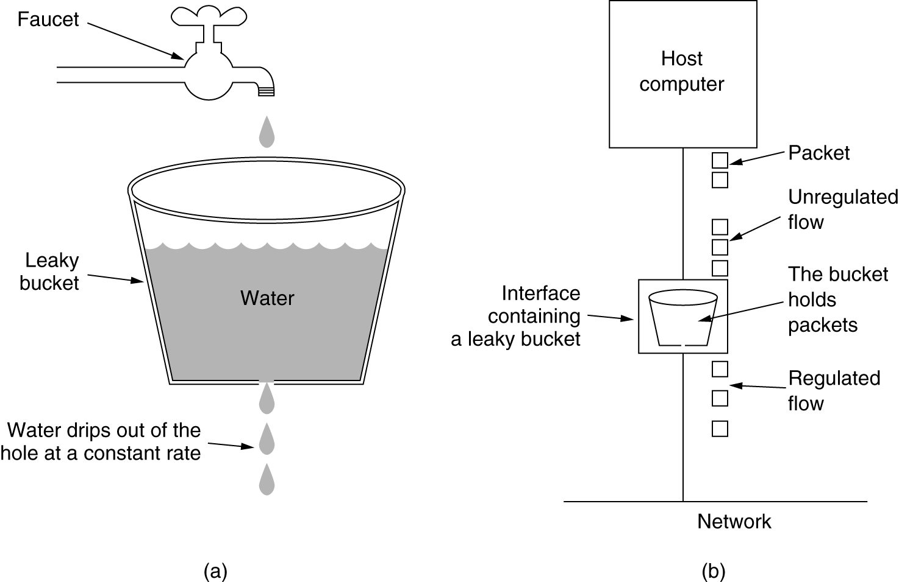
The Leaky Bucket Algorithm
(a) A leaky bucket with water. (b) a leaky bucket with packets.
Notes:
主机在不停的发送数据，接收数据进入到bucket holds packets中，网络内部收到后是按照固定的速度来发，进而到达流量监控效果
但是不能满足某些应用

Slide 13
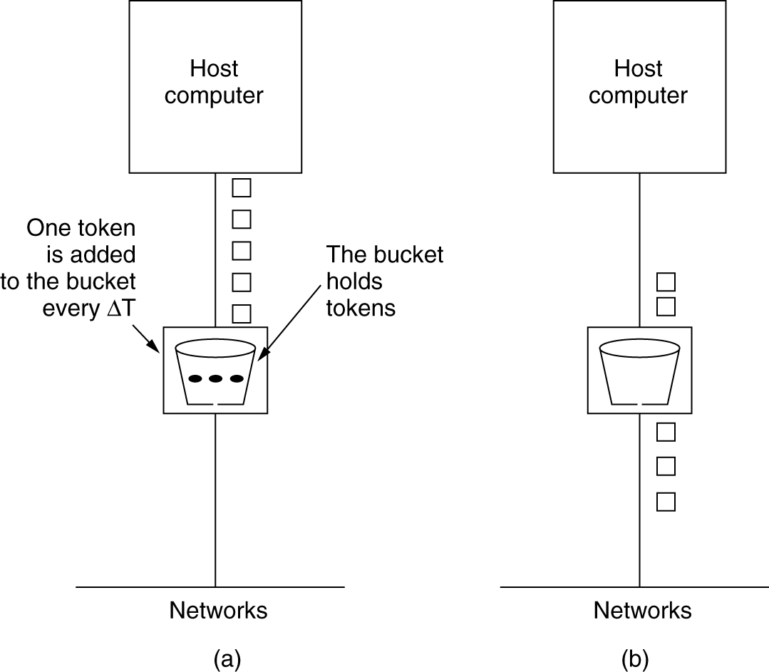
The Token Bucket Algorithm
5-34
(a) Before. (b) After.
Notes:
产生一个令牌，如果很长时间没有发送数据，那么桶里的令牌会变多，表示曾经可以发，但是没有发；当有数据要发送时，看桶里的令牌，如果令牌多，那么没发的数据就多
如果令牌满了，再产生也没用

Slide 14
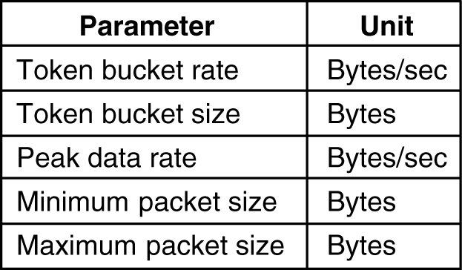
Admission Control
5-34
An example of flow specification.

Slide 15
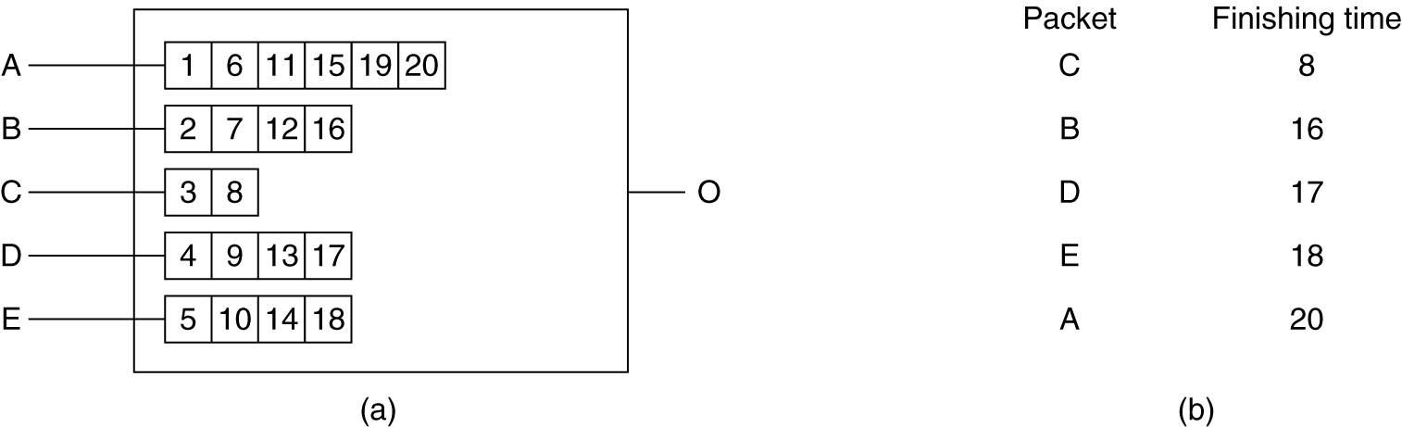
Packet Scheduling
(a) A router with five packets queued for line O.
(b) Finishing times for the five packets.
Notes:
路由器：先来先发
那么可能会造成FTP的数据包先发，视频的数据包被搁置
所以要优先处理视频数据包，即使后到也要先发，放在一个优先队列里
判断是视频数据包：
包里有个type ofservice，里面放的是优先级的等级
但是这个等级不好判断，不同的子网对不同的数据等级是不一样的，所以不常用这个方法
有的子网支持这个方法，有的不支持

Slide 16
Internet QoS Architecture
Integrated Service(IntServ)
  flow-based algorithms
  RSVP(The Resource reSerVation Protocol): used for making the reservations
Differentiated Service(DiffDServ)
  class-based algorithms
  expedited Forwarding: The expedited packets should be able to transit the subnet as though no other packets were present
  assured forwarding: specifies that there shall be four priority classes, each class having its own resources. In addition, it defines three discard probabilities for packets that are undergoing congestion: low, medium, and high.
MPLS(MultiProtocol Label Switching )
Notes:
Integrated Service(IntServ：
如果要实现端到端的通讯，并且保证服务质量，则不是给每个包优先等级，而是在两个主机通信之前，为他们的网络层通信建立一条连接，每个主机的包通过该连接传输，连接路上的每个路由器都预留了资源，在路由器里预留接收端口的接收缓存，保证数据包不丢失；还保证路由器有处理的时间可以把包转发出去
但是，这个算法的协议只能在小的网络中使用，不能在互联网上使用，因为有很多端到端的通信是跨广域网的，需要通过D级子网，因为有很多端到端，如果每个端到端都在高级路由器里产生一条连接，那么连接数量是很大的，如果来了一个包，那么路由器要判断这个包是哪个连接上的，就花费很多时间

Slide 17
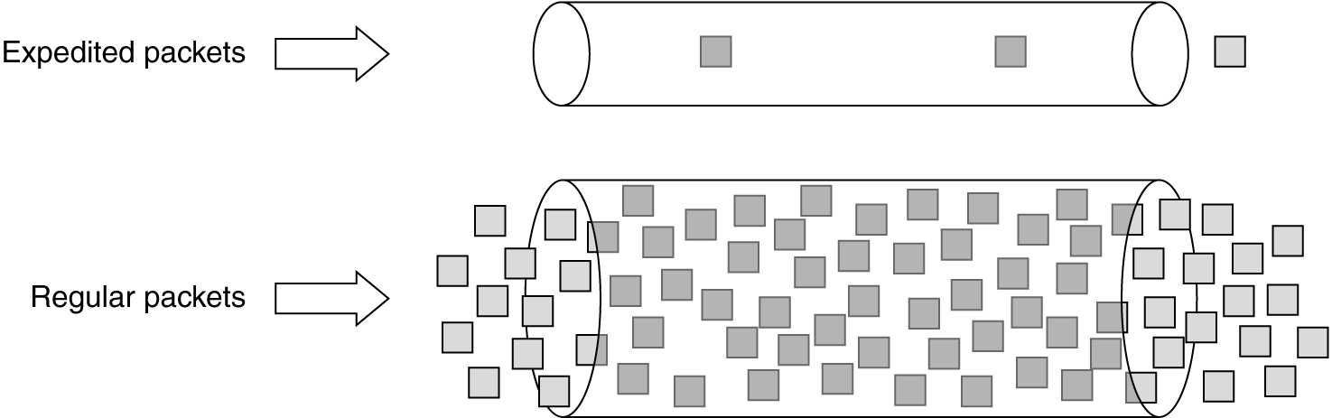
Expedited Forwarding
Expedited packets experience a traffic-free network.

Slide 18
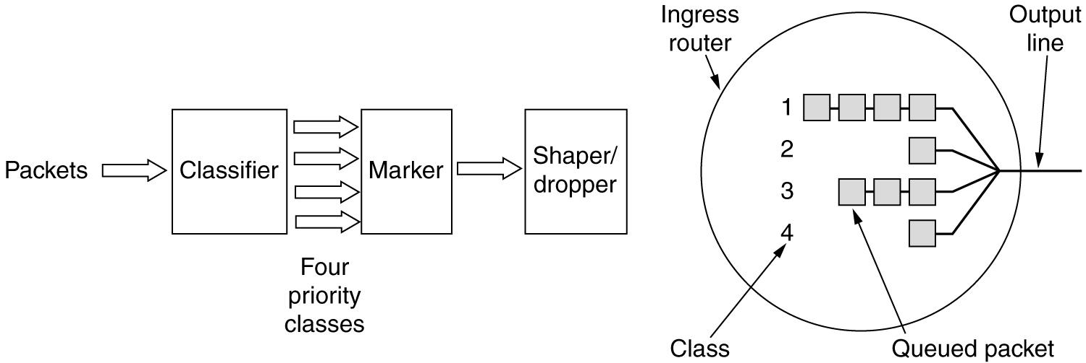
Assured Forwarding
A possible implementation of the data flow for assured forwarding.

Slide 19
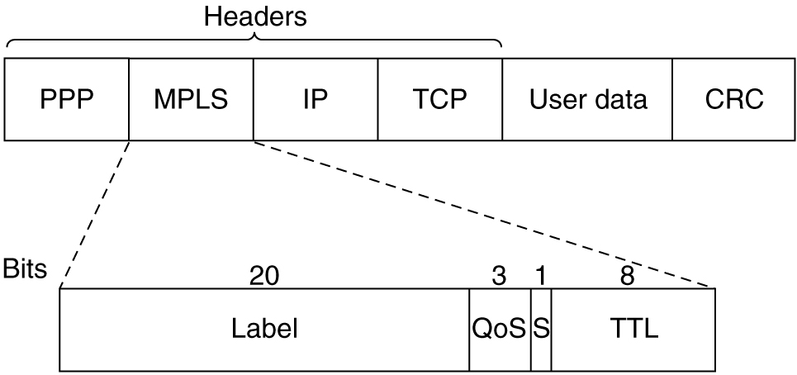
Label Switching and MPLS
Transmitting a TCP segment using IP, MPLS, and PPP.

Slide 20
Summary
Congestion Control Algorithms
  Why?
  Classification of Congestion Control Algorithms
Quality of Service
  QoS Requirements: Why is QoS support needed?
  Techniques for Achieving Good Quality of Service
  Internet QoS Architecture

